Slide 1


BABU BANARASI DAS UNIVERSITY, LUCKNOW
NAME – KRISHNA SWAROOP SRIVASTAVA CLASS – BCADS24 ROLL NO – 02
SUBMITTED TO – MR. HEMANT TRIPATHI
SUBJECT – DESCRIPTIVE ANALYTICS

Slide 2
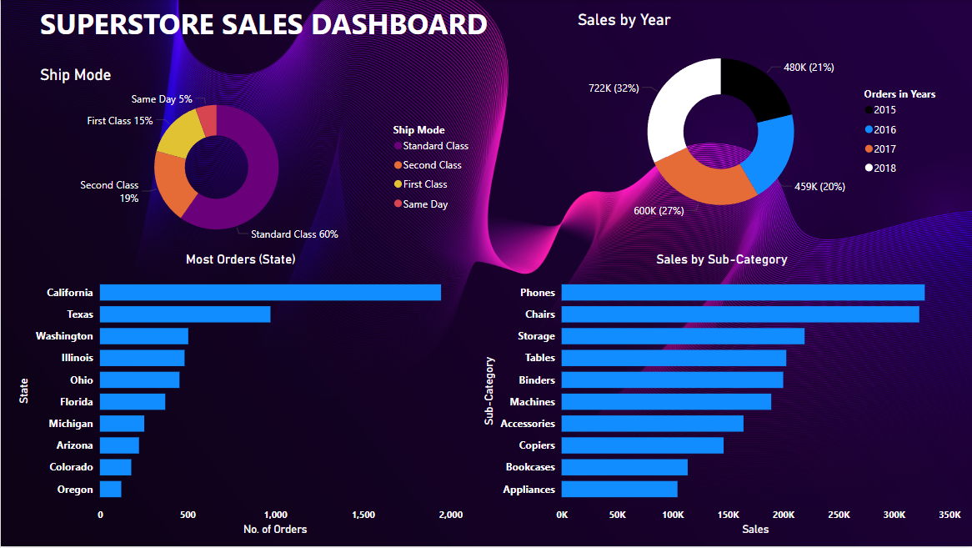
THIS IS THE FINAL OUTPUT , AS YOU HAVE SEEN IN MY POWERBI PROJECT !!

Slide 3
OBJECTIVES :-
Analyze Shipping Modes : To identify the most used shipping mode and its distribution among orders.
Sales Performance by Year : To observe yearly sales trends and determine sales growth or decline over a four-year period.
State-Level Order Volume : To find the states with the highest number of orders, helping target areas with strong sales potential.
Sub-Category Sales Analysis : To determine the top-performing product sub-categories based on sales volume.

Slide 4
INSIGHTS:-
Shipping Mode Usage : Standard Class is the most popular shipping mode, accounting for 60% of orders, followed by Second Class (19%), First Class (15%), and Same Day (5%).
Yearly Sales Trend : The highest sales occurred in 2018 (32%), followed by 2017 (27%), 2016 (20%), and 2015 (21%). This indicates an upward trend in sales over time.
Top States for Orders : California leads with the highest number of orders, significantly outpacing other states. Other high-performing states include Texas, Washington, Illinois, and Ohio, showing concentrated demand in these regions.
Best-Selling Product Sub-Categories : Phones and Chairs are the top-selling sub-categories, indicating high demand for these products. Other strong categories include Storage, Tables, and Binders.
Growth Opportunities : Lesser-performing sub-categories (e.g., Bookcases and Appliances) might require marketing strategies or product improvements.

Slide 5
METHODOLOGY:-
1. Fetched Dataset from Kaggle.
2. Imported Data on PowerBI .
3. Transformed Data (Deleted few columns like Customer name and Row Id etc.)
4. Then made the first Donut chart of Sales by year by placing Order Date and sales.
(To know the yearly sales from 2015 to 2018)
5. Then made the Clustered Bar Chart by placing Sub-category on Y-axis and sales on X-axis.
(To know the most Bought product). Also used filtering to get Top 10 Products.
6. After that , I made the second Clustered Bar Chart by placing States on Y-axis and Postal code on X-axis.
(To know the top states we get most orders from). Used filtering to get Top 10 states.
Used count filter to count total number of postal code from a state.
Lastly made the 2nd Donut Chart of Shipping mode by using Ship mode and postal code dataset.
(To know the most shipping mode usage).
Design – only focused on making the first donut chart look good ,, later used the FORMAT PAINTER TOOL to copy the same effects to other charts.

Slide 6
THANK YOU

